Slide 1
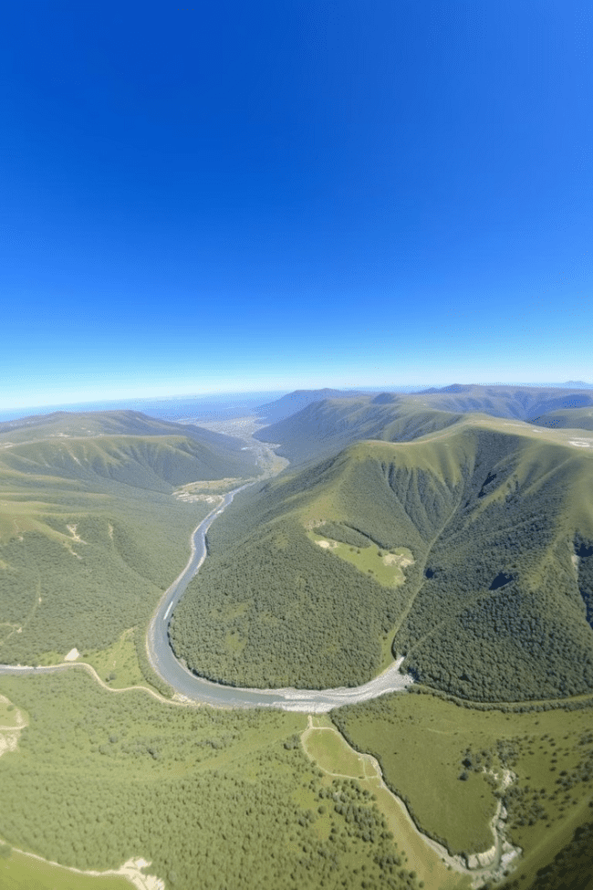
Forecasting Future Water Requirements and Assessing Storage
This presentation outlines a deep learning and machine learning model.
It forecasts water availability, demand with population and rainfall.

Slide 2
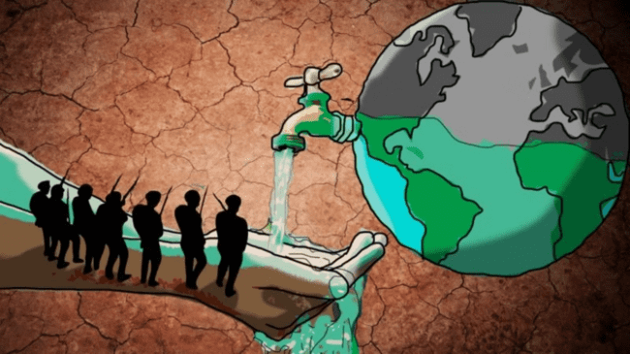
Introduction:
Introduction: The Need for Smart Water Management
Water scarcity is a growing concern due to rising demand and climate change. Traditional methods struggle to predict future water needs and availability, leading to inefficiencies.
This project leverages deep learning and MlL to analyze historical data and provide accurate water demand and availability forecasts, enabling better resource planning and sustainability.

Slide 3




Problem Statement: Challenges in Water Demand & Availability
The project uses advanced machine learning to forecast water needs.
It combines models for water availability and consumption.
The goal is smarter water resource management and planning.
Availability
Demand
Storage
Models predict future water resources.
Models forecast changes in water consumption.
Tools assess current and required capacity.

Slide 4
Project Objectives: Enhancing Water Resource Planning
This project focuses on predicting water demand and availability using historical data on consumption, rainfall, and reservoir levels. It helps policymakers and water managers make informed decisions for efficient allocation and conservation, ensuring sustainable water use.
We developed a machine learning model to predict rainfall.
The model analyzes historical weather data to forecast availability.
Improved accuracy supports better water resource planning.
Data Sources
Model Type
Historical weather patterns.
Time series forecasting & Random Forest
Population data.
Deep neural networks.

Slide 5

Methodology:
Predicting Water Demand Based on Population Growth and Consumption
We forecast future water demand based on population growth.
The model considers consumption rates and demographic shifts.
This helps ensure adequate supply for growing communities.
1
Population Models
2
Consumption Analysis
Growth projections.
Usage patterns.
3
Predictive Modeling
Demand forecasting.

Slide 6
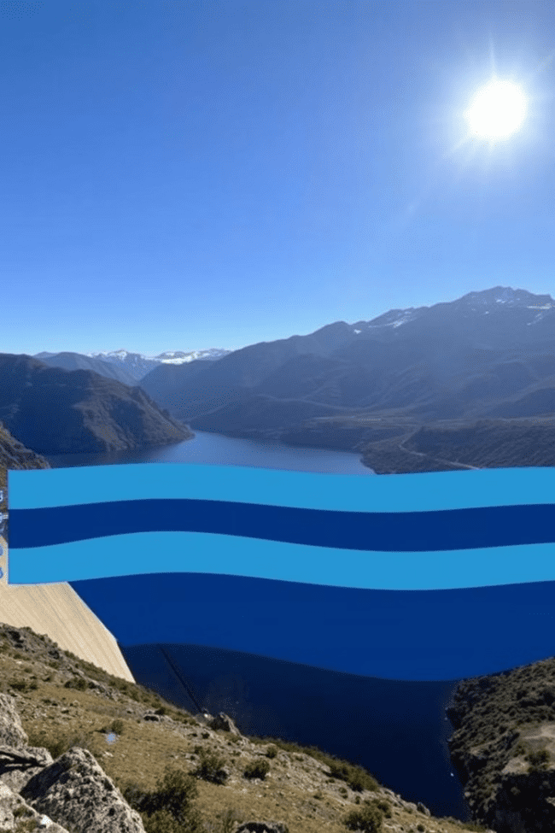



Assessing Water Storage Capacity: Current vs. Future Needs
We evaluated current water storage capacity and future needs.
The assessment helps identify potential storage deficits or surpluses.
This helps inform decisions about new storage infrastructure.
Current Capacity
Evaluate existing storage resources.
Future Demand
Predict long-term water needs.
Gap Analysis
Identify storage shortfalls or surpluses.

Slide 7
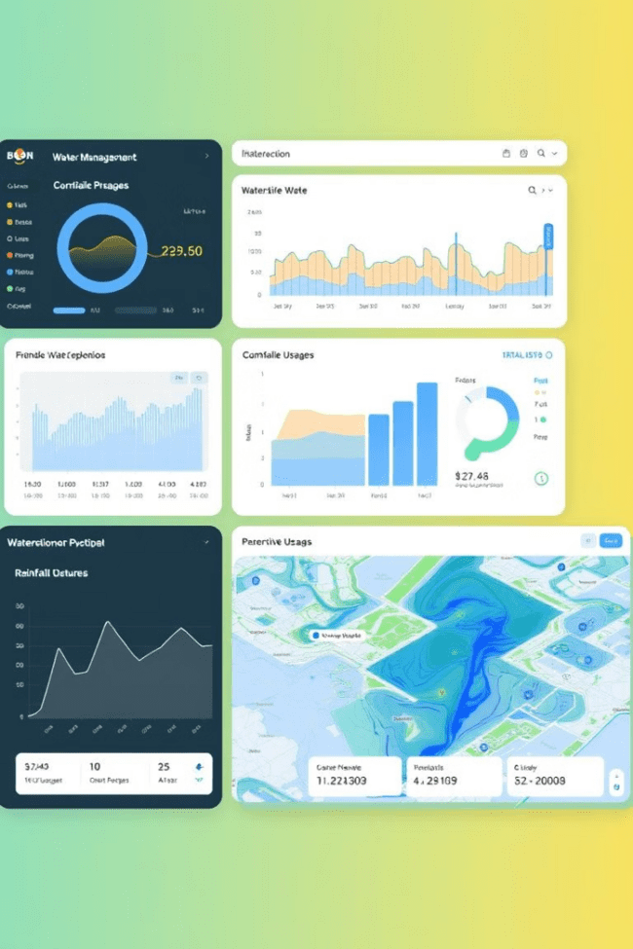
Web Application Interface: Visualizing Forecasts and Storage
A web application displays our forecasts and storage data.
Users can interact with the models and scenarios.
Interactive visualization aids water management decisions.
Interactive Maps
Forecast Charts
Geographic water data.
Demand projections.
Storage Metrics
Capacity indicators.

Slide 8
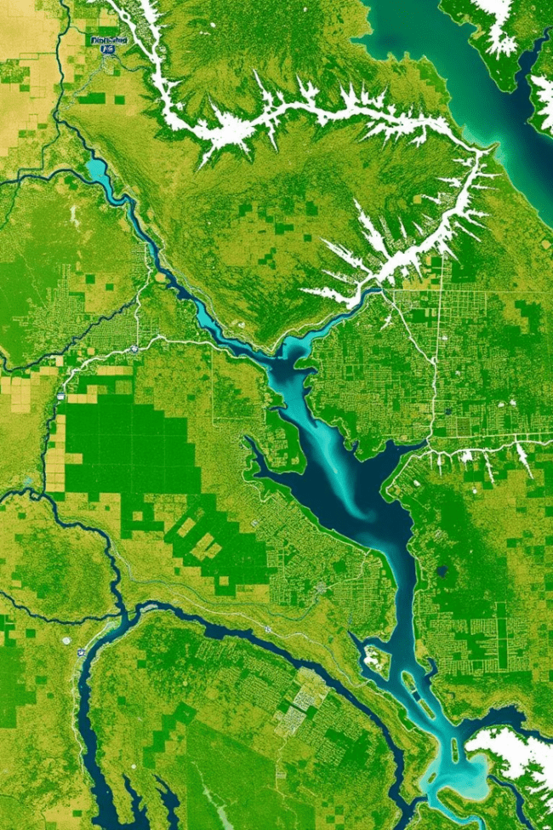
Case Study: Applying the Model to [Specific Region]
The model has been applied to [Specific Region].
This shows the practical impact for planning.
It supports better water planning and management.
1
Data Collection
Region-specific data gathered.
2
Model Calibration
Model parameters fine-tuned.
3
Forecast Generation
Future water conditions predicted.

Slide 9
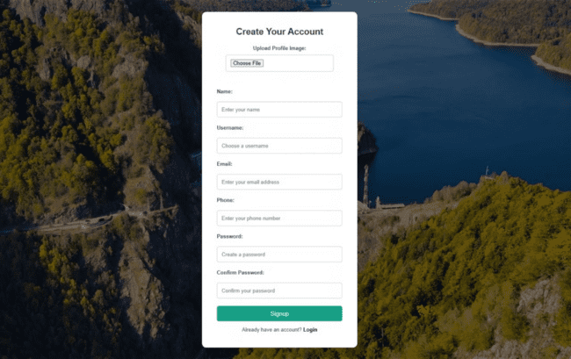
Creating Account Page
Users can create an account to access personalized forecasts and storage metrics.
This feature enables users to save their preferences and settings.
Account creation also allows for tracking historical data and patterns.

Slide 10
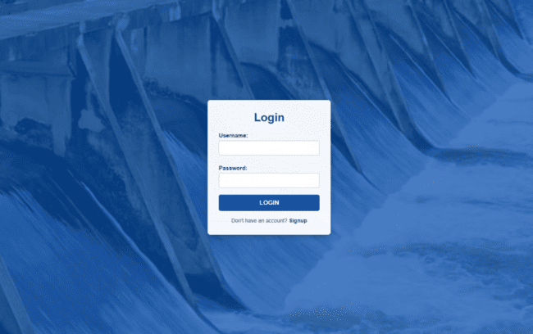
Login Page
Users can securely access their accounts with a personalized login.
Account login ensures user-specific information is protected.
This page provides a gateway to the personalized features available to registered users.

Slide 11
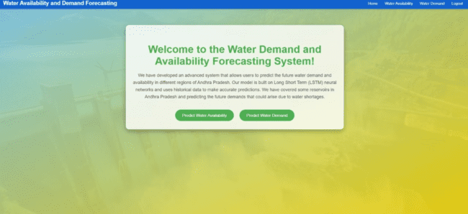
Water Demand and Forecasting System Page
This page offers insights into water usage and future predictions based on collected data.
Users can make informed decisions about their water consumption by utilizing the forecasting system.
The system provides valuable information to help users manage their water resources more effectively.

Slide 12
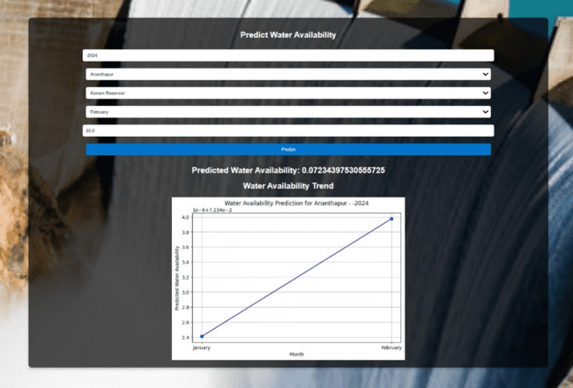
Prediction of Water Availability Page
This page displays current water availability and predicts future water supply based on various factors. Users can access real-time data and forecasts to plan water usage efficiently and sustainably. By leveraging this information, users can optimize their water consumption and contribute to water conservation efforts.

Slide 13



Conclusion: Implications and Future Development
Our model enables proactive water management strategies.
It ensures communities have water now and in the future.
We plan ongoing model refinement for continuous improvement.
2
Model Refinement
1
Data Updates
Planning Support
3

